Slide 1
Hadoop Features
Dr.Preethi Ananthachari
Asst.Professor
Endicott College of International Studies
Woosong University
Preethi.ga@wsu.ac.kr

Slide 2
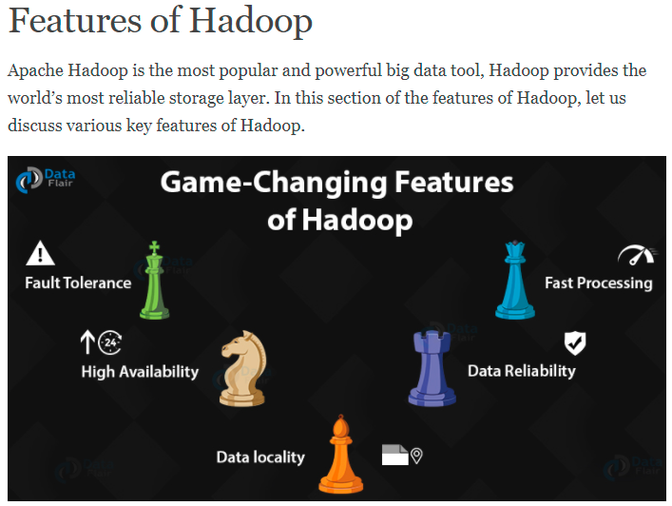

Slide 3
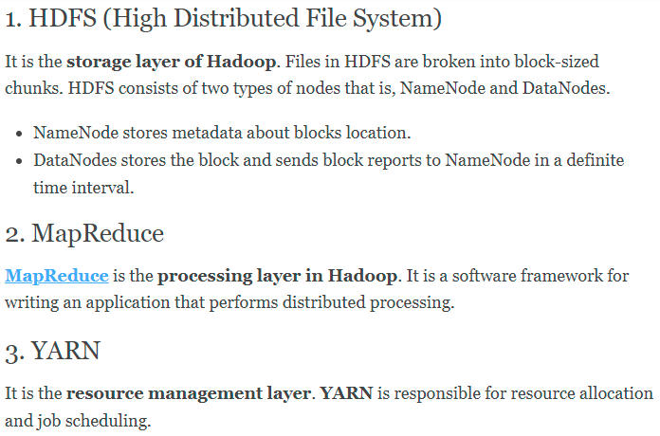

Slide 4
Features in Detail
Open source – free availability of source code.
Highly scalable – add any number of nodes
Fault tolerance – Hadoop 2 uses “replication” mechanism. Hadoop 3 uses “Erasure code”.
High Availability – copies of data in different data nodes. Name nodes (active – running, passive – standby)

Slide 5
Cost effective – cluster of nodes uses commodity hardware.
Faster data processing – Distributed cluster of nodes.
Feasibility – Process unstructured data.
Data Reliability – Due to replication.

Slide 6
Hadoop Eco System
These ecosystem components are actually different services deployed by the various enterprise.
We can integrate these to work with a variety of data.
Each of the Hadoop Ecosystem Components is developed to deliver explicit function.
And each has its own developer community and individual release cycle.

Slide 7
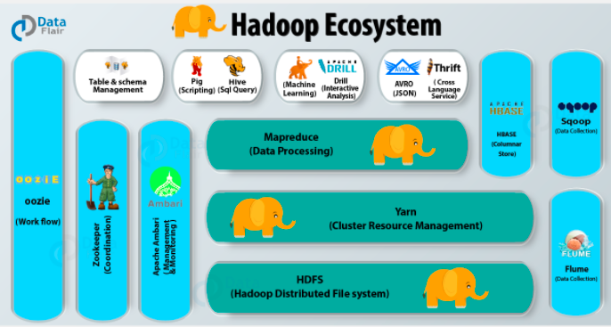

Slide 8
1. HDFS
HDFS is the foundation of Hadoop and hence is a very important component of the Hadoop ecosystem.
It is Java software that provides many features like scalability, high availability, fault tolerance, cost effectiveness etc.

Slide 9
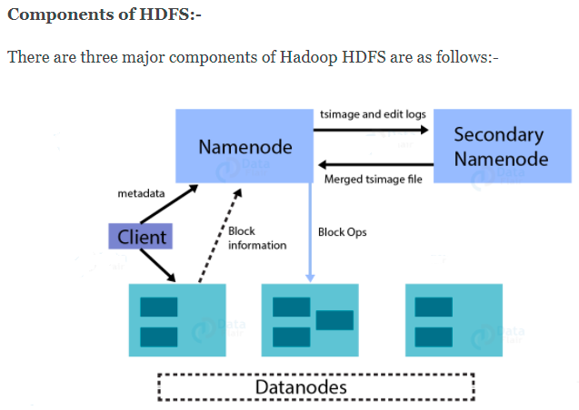

Slide 10
Data Node –
DataNode does handshake with NameNode.
It sends a block report to NameNode.
It sends a heartbeat to NameNode every 3 seconds to tell that it is alive.
Name Node –
FSImage – FSImage is a point-in-time snapshot of HDFS’s metadata. It contains information like file permission, disk quota, modification timestamp, access time etc.
Edits log – It contains modifications on FSImage. It records incremental changes like renaming the file, appending data to the file etc.

Slide 11
Secondary NameNode
If the NameNode has not restarted for months the size of Edits log increases. This, in turn, increases the downtime of the cluster on the restart of NameNode.
In this case, Secondary NameNode comes into the picture. The Secondary NameNode applies edits log on FSImage at regular intervals. And it updates the new FSImage on primary NameNode.

Slide 12
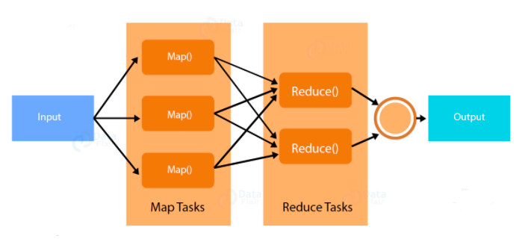
2. Map Reduce

Slide 13
Mapper reads the block of data and converts it into key-value pairs.
Now, these key-value pairs are input to the reducer.
The reducer receives data tuples from multiple mappers.
Reducer applies aggregation to these tuples based on the key.
The final output from reducer gets written to HDFS.

Slide 14
3. Yarn
Yarn which is short for Yet Another Resource Manager. It is like the operating system of Hadoop as it monitors and manages the resources.
It handles the workloads like stream processing, interactive processing, batch processing over a single platform. Yarn has two main components – Node Manager and Resource Manager.

Slide 15
Node Manager
It is Yarn’s per-node agent and takes care of the individual compute nodes in a Hadoop cluster.
It monitors the resource usage like CPU, memory etc. of the local node and intimates the same to Resource Manager.
Resource Manager
It is responsible for tracking the resources in the cluster and scheduling tasks like map-reduce jobs.

Slide 16
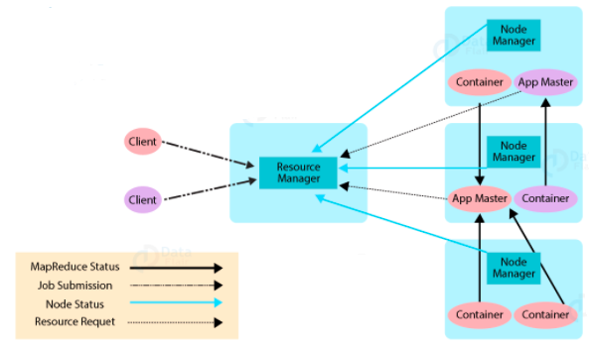

Slide 17
Application Master has two functions and they are:-
Negotiating resources from Resource Manager
Working with NodeManager to monitor and execute the sub-task.
Functions of Resource Scheduler:-
It allocates resources to various running applications
But it does not monitor the status of the application. So in the event of failure of the task, it does not restart the same.
We have another concept called Container. It is nothing but a fraction of NodeManager capacity i.e. CPU, memory, disk, network etc.

Slide 18
4. Hive
It is a Data warehouse which provides Data query and analysis.
Hive Query Language - translates the queries Into the corresponding map-reduce job.
MetaStore – it stores metadata
Driver – Manages the lifecycle of HQL statement
Query compiler – Compiles HQL into DAG i.e. Directed Acyclic Graph
Hive server – Provides interface for JDBC/ODBC server.

Slide 19
5. Pig
Pig is a SQL like language used for querying and analyzing data stored in HDFS.
Yahoo was the original creator of the Pig. It uses pig latin language.
It loads the data, applies a filter to it and dumps the data in the required format.
Pig also consists of JVM called Pig Runtime.

Slide 20
Extensibility – For carrying out special purpose processing, users can create their own custom function.
Optimization opportunities – Pig automatically optimizes the query allowing users to focus on semantics rather than efficiency.
Handles all kinds of data – Pig analyzes both structured as well as unstructured.

Slide 21
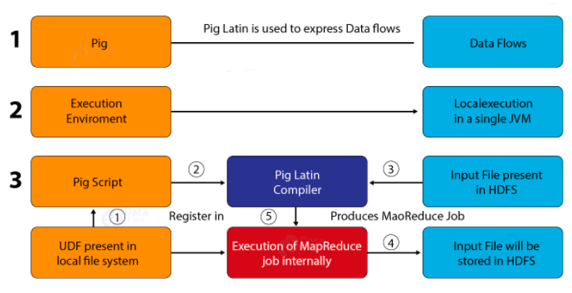

Slide 22
How does Pig work?
First, the load command loads the data.
At the backend, the compiler converts pig latin into the sequence of map-reduce jobs.
Over this data, we perform various functions like joining, sorting, grouping, filtering etc.
Now, you can dump the output on the screen or store it in an HDFS file.

Slide 23
6. HBase
HBase is a NoSQL database built on the top of HDFS.
The various features of HBase are that it is open-source, non-relational, distributed database.
It imitates Google’s Bigtable and written in Java.

Slide 24
a. HBase Master
HBase performs the following functions:
Maintain and monitor the Hadoop cluster.
Performs administration of the database.
Controls the failover.
HMaster handles DDL operation.

Slide 25
b. RegionServer
Region server is a process which handles read, writes, update and delete requests from clients.
It runs on every node in a Hadoop cluster that is HDFS DataNode.
HBase is a column-oriented database management system. It runs on top of HDFS.

Slide 26
7. Mahout
Mahout provides a platform for creating machine learning applications which are scalable.
Collaborative filtering – Mahout mines user behavior patterns and based on these it makes recommendations to users.
Clustering – It groups together a similar type of data like the article, blogs, research paper, news etc.

Slide 27
Classification – It means categorizing data into various sub-departments. For example, we can classify article into blogs, essays, research papers and so on.
Frequent Itemset missing – It looks for the items generally bought together and based on that it gives a suggestion.
For instance, usually, we buy a cell phone and its cover together. So, when you buy a cell phone it will give suggestion to buy cover also.

Slide 28
8. Zookeeper
Zookeeper coordinates between various services in the Hadoop ecosystem.
It saves the time required for synchronization, configuration maintenance, grouping, and naming.
Speed – Zookeeper is fast in workloads where reads to data are more than write. A typical read: write ratio is 10:1.
Organized – Zookeeper maintains a record of all transactions.

Slide 29
Simple – It maintains a single hierarchical namespace, similar to directories and files.
Reliable – We can replicate Zookeeper over a set of hosts and they are aware of each other. There is no single point of failure.
Why do we need Zookeeper in Hadoop?
Hadoop faces many problems as it runs a distributed application.

Slide 30
One of the problems is deadlock. Deadlock occurs when two or more tasks fight for the same resource.
For instance, task T1 has resource R1 and is waiting for resource R2 held by task T2. And this task T2 is waiting for resource R1 held by task T1. In such a scenario deadlock occurs. Both task T1 and T2 would get locked waiting for resources.
Zookeeper solves Deadlock condition via synchronization.

Slide 31
Another problem is of race condition.
This occurs when the machine tries to perform two or more operations at a time.
Zookeeper solves this problem by property of serialization.

Slide 32
9. Oozie
It is a workflow scheduler systems for managing Hadoop jobs.
It supports Hadoop jobs for Map-Reduce, Pig, Hive, and Sqoop.
Oozie combines multiple jobs into a single unit of work. It is scalable and can manage thousands of workflow in a Hadoop cluster.
Oozie works by creating DAG i.e. Directed Acyclic Graph of the workflow.
It is very much flexible as it can start, stop, suspend and rerun failed jobs.
Oozie is an open-source web-application written in Java

Slide 33
10. Apache Spark
Apache Spark unifies all kinds of Big Data processing under one umbrella.
It has built-in libraries for streaming, SQL, machine learning and graph processing. Apache Spark is lightening fast.
It gives good performance for both batch and stream processing.
It does this with the help of DAG scheduler, query optimizer, and physical execution engine.
Spark offers 80 high-level operators which makes it easy to build parallel applications.

Slide 34
Spark has various libraries like MLlib for machine learning, GraphX for graph processing, SQL and Data frames, and Spark Streaming.
One can run Spark in standalone cluster mode on Hadoop, Mesos, or on Kubernetes.
One can write Spark applications using SQL, R, Python, Scala, and Java. As such Scala in the native language of Spark.
It was originally developed at the University of California, Berkley. Spark does in-memory calculations. This makes Spark faster than Hadoop map-reduce.

Slide 35

Simple file test

Slide 36
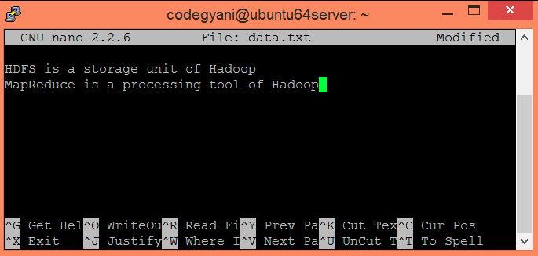

Slide 37
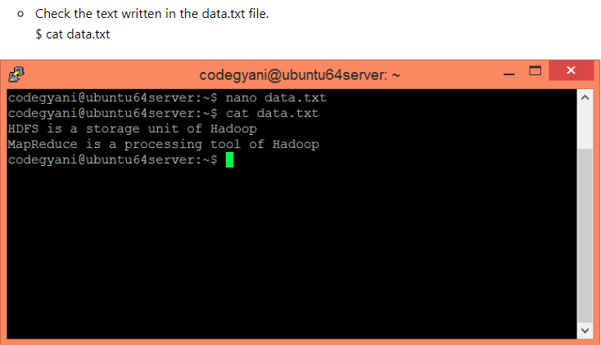

Slide 38
